Slide 1

Customer Shopping Behavior Analysis
Uncovering spending patterns, customer segments, and subscription behavior from 3,900 purchases across categories.

Slide 2
DATASET
The Dataset at a Glance
3,900
18
37
Rows
Columns
Missing Values
Transactional purchases
Rich feature set
In Review Rating column
Key features span demographics, purchase details, and shopping behavior.

Slide 3
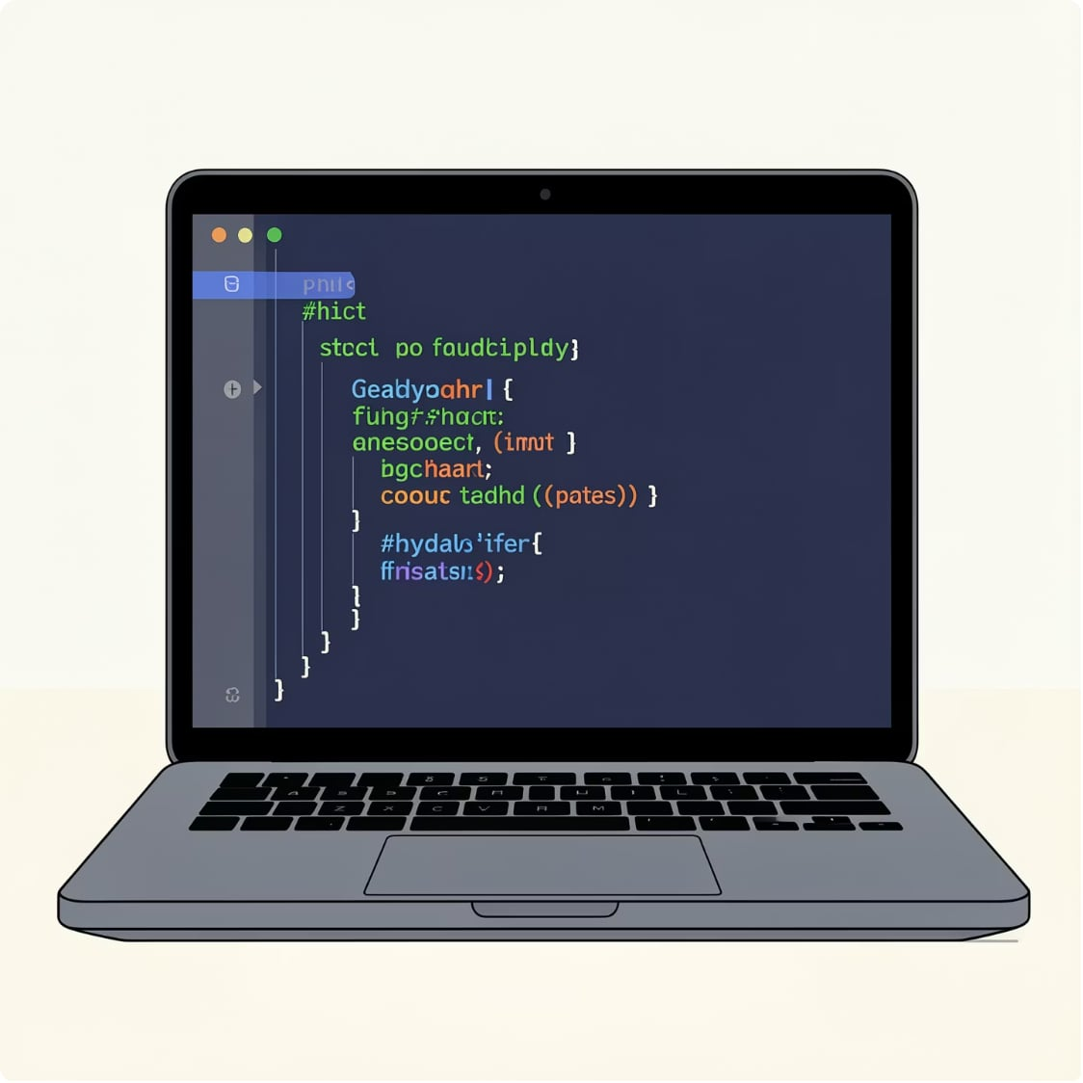
EDA
Data Preparation in Python
01
Data Loading & Exploration
Imported via pandas; explored with df.info() and .describe()
02
Cleaning & Imputation
Median imputation by category for missing review ratings
03
Feature Engineering
Created age_group and purchase_frequency_days columns
04
Database Integration
Loaded cleaned data into MySQL for SQL analysis

Slide 4
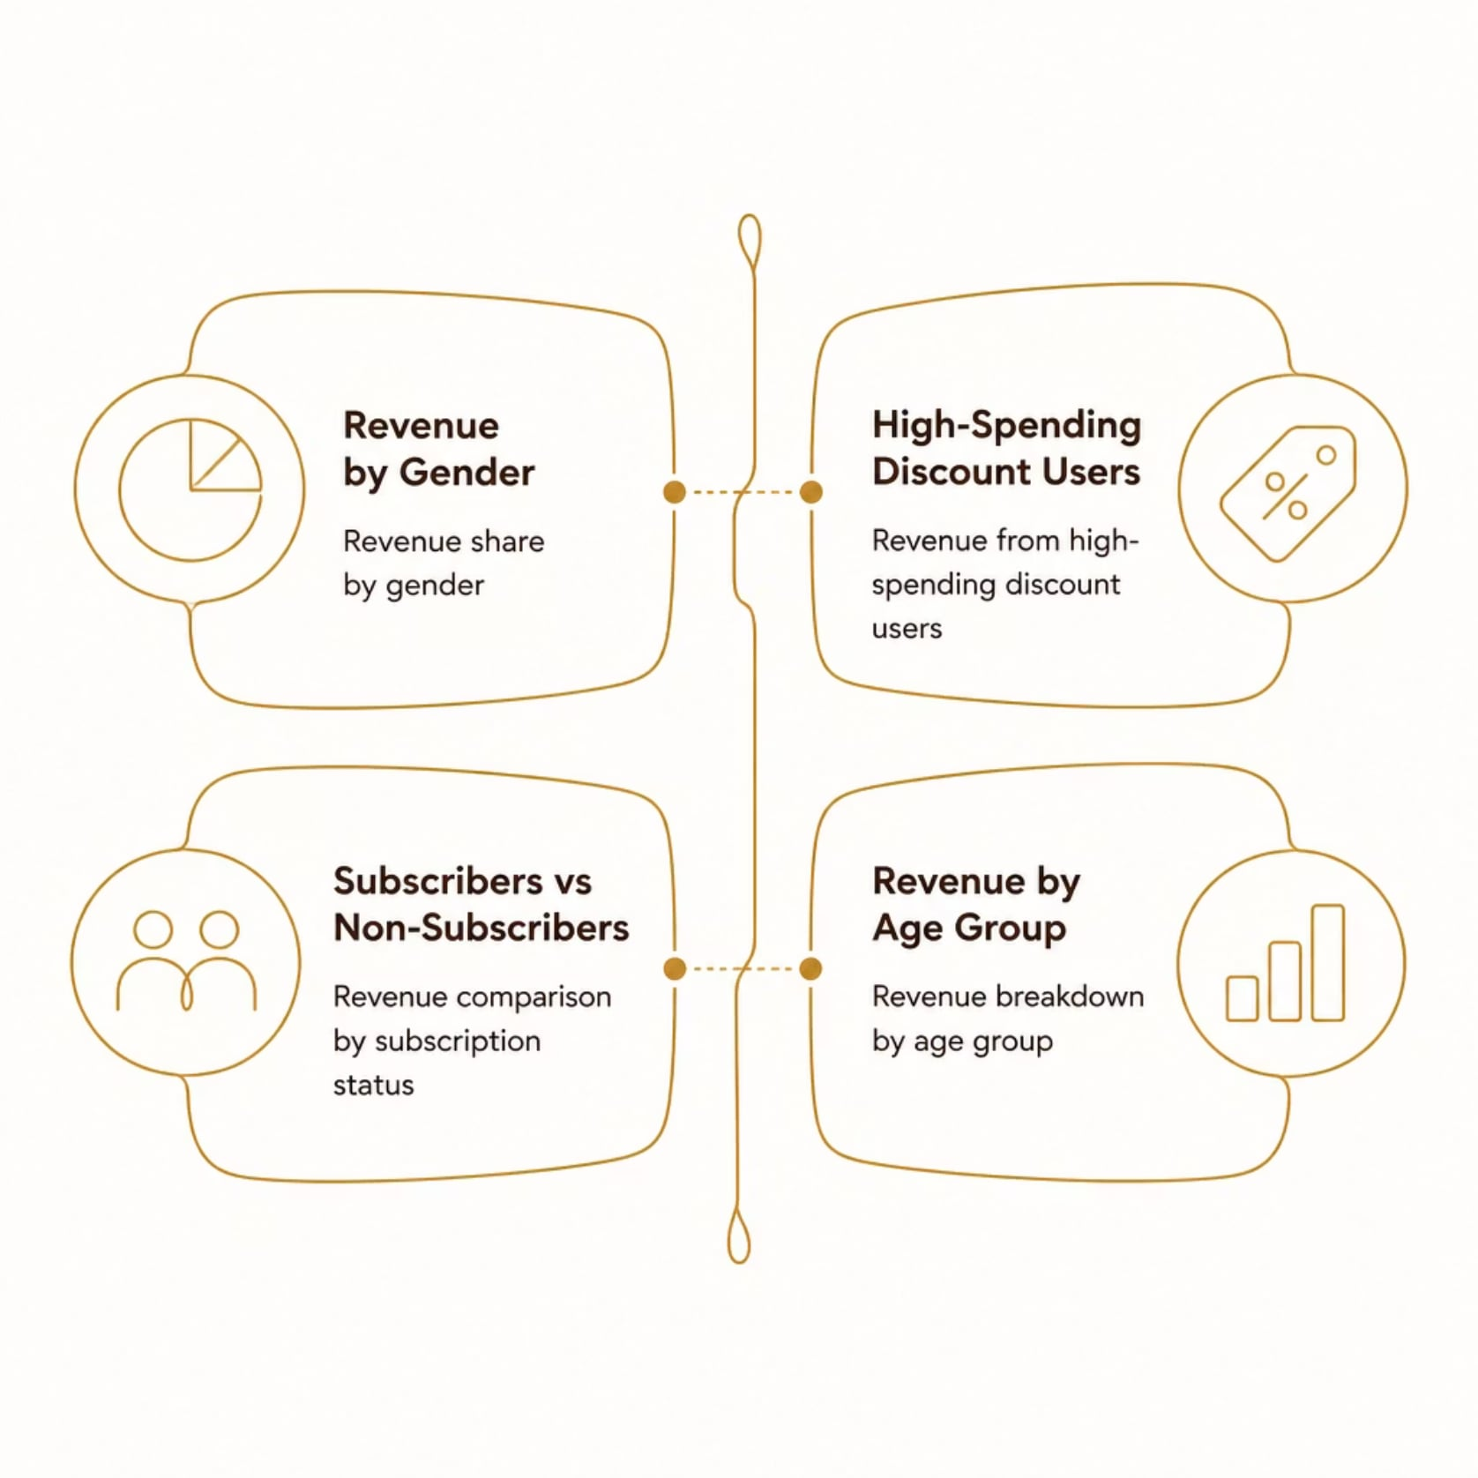
SQL ANALYSIS
Revenue & Spending Insights
Key Findings
Revenue compared by gender
High-spending discount users identified
Subscribers vs non-subscribers spend compared
Revenue contribution by age group

Slide 5
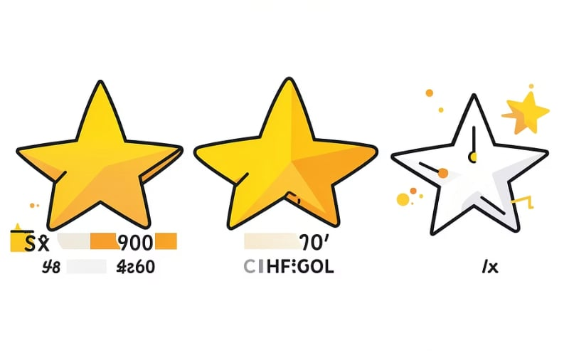

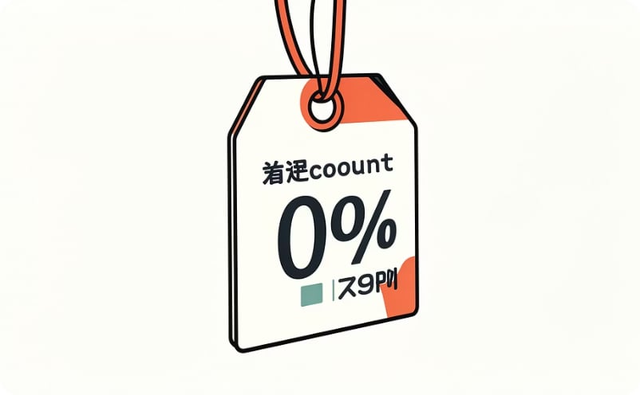
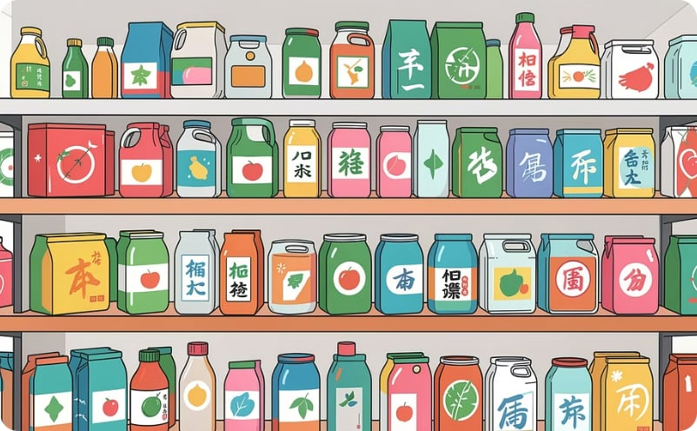
SQL ANALYSIS
Product & Shipping Analysis
Top 5 Products by Rating
Shipping Comparison
Discount-Dependent Products
Top 3 Products per Category
Highest average review ratings identified
Standard vs Express average spend
Top 5 by discounted purchase percentage
Most purchased within each category

Slide 6

SQL ANALYSIS
Customer Segmentation
Segment Classifications
Customers classified by purchase history into three tiers.
New — first-time buyers
Returning — repeat purchasers
Loyal — high-frequency buyers
New Customers
Loyal Customers
Returning Customers
Repeat buyers with >5 purchases checked for subscription likelihood.

Slide 7
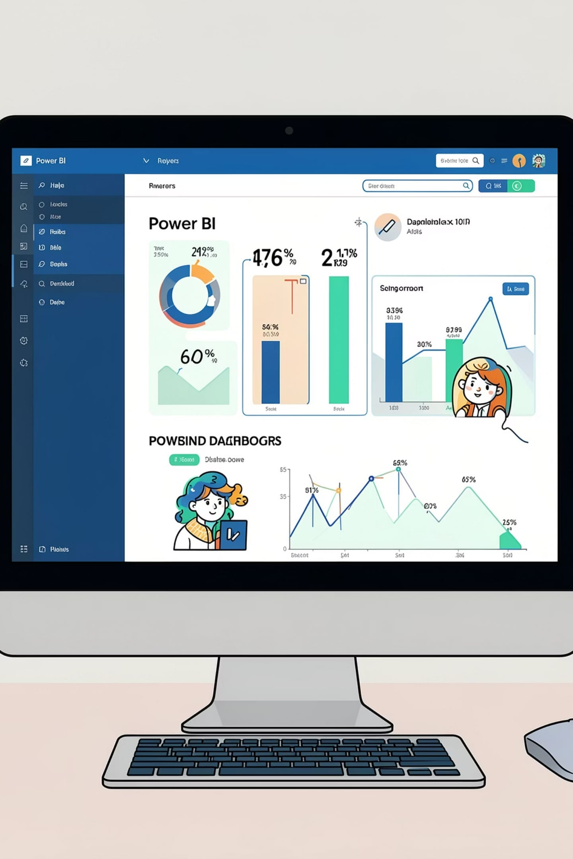
VISUALIZATION
Interactive Power BI Dashboard
Built to present all insights visually — enabling dynamic filtering and real-time exploration of customer behavior.

Slide 8


RECOMMENDATIONS
Strategic Recommendations
1
2
3
Boost Subscriptions
Loyalty Programs
Review Discount Policy
Promote exclusive subscriber benefits
Reward repeat buyers to reach "Loyal" segment
Balance sales boosts with margin control
4
5
Product Positioning
Targeted Marketing
Highlight top-rated and best-selling products
Focus on high-revenue age groups and express users

Slide 9

From Data to Decisions
Python · MySQL · Power BI — a full-stack analytics pipeline transforming raw transactions into actionable strategy.

Slide 10
THANK YOU
Questions?
Let's discuss the insights and how they can shape your business strategy.

